Slide 1
Education Safeguarding Service
Toby Jenkins
Service Manager
Education Roadshows – December 2022
Notes:
www.somerset.gov.uk/ess/schools-safeguarding-audit

Slide 2
What the ESS does
The Education Safeguarding Service supports children, families, schools and other support services to ensure all children have engaged with safe, appropriate, full-time education and improve attendance.

Slide 3
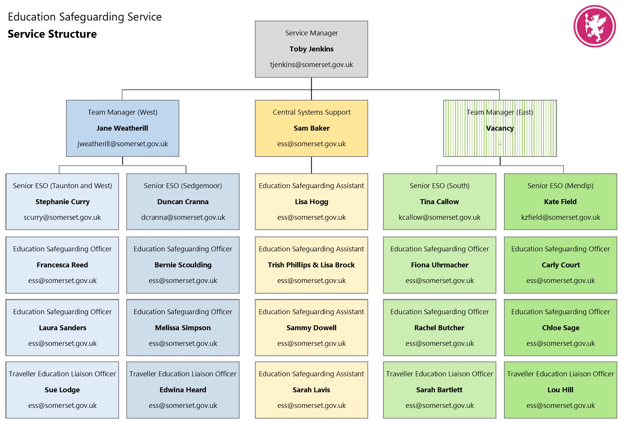
Vacancy
Senior ESO (Taunton)
Beth Ollive
Education Safeguarding Assistant
Sammy Gibb
Vacancy
Education Safeguarding Officer
Sarah Bartlett
Education Safeguarding Officer
Sarah Mutch
Vacancy
Education Safeguarding Assistant
Jennifer Cox
Vacancy

Slide 4
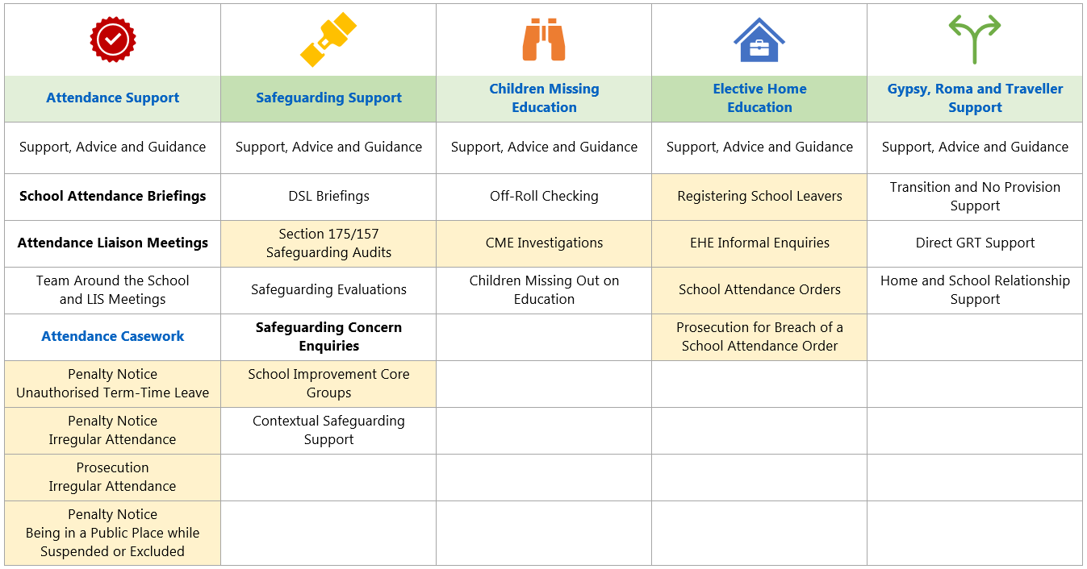
Our Core Offer
The shaded yellow boxes show our statutory functions

Slide 5
Children Missing from Education
Support and guidance for schools
Online resources
CME and No Provision enquiries
CMOE panel
CME notification form (schools)
Data sets and dashboards (CMOE panel)
Direct referral (other services)

Slide 6
GRT Support
Support and guidance for schools
Attendance and engagement support
Transition support
Home/school liaison
GRT support request form
Direct referral (TELOs)

Slide 7
Safeguarding Support
Support and guidance
DSL briefings
Section 175/157 safeguarding audits
Ofsted complaint enquiries
Safeguarding evaluations
Direct referral
Complaints via Ofsted
Data analysis

Slide 8
Elective Home Education
Support and guidance for schools
Recording and triaging new EHE starters
EHE informal enquiries
Issuing school attendance orders
EHE legal work
EHE notification form
Direct referral (other services)

Slide 9
Elective Home Education
1,513 children registered as home educated in Somerset
1.5% of all school-aged children in Somerset
Net increase of around 9% since the pandemic
16% have recognised SEND and/or an EHC Plan
1.5% have active CIN and CP plans
ESS investigates cases where there are concerns about the education being provided
This may lead to school attendance orders being issued

Slide 10
Who can be home educated?
All parents and carers have the right to choose how their child is educated, including home education.
Exceptions to this are:
When a child attends a special school named in their EHCP
When a child is looked-after (CLA)
When a school attendance order is in place for that child
In these cases, consent from the LA is required before a child can be home educated
Children on CIN and CP plans can be home educated

Slide 11
CSC and Home Education
Home education can be suitable for children on CIN and CP plans
Home education for CLA is feasible, but highly unusual
Home education does not need to “look like school”
When there are concerns about provision
Schools report concerns direct to ESS
ESS makes enquiries into cases of EHE when it is possible that the child is not receiving suitable, full-time education
All practitioners supporting families should consider whether home education is or seems suitable for the child

Slide 12
A Typical EHE Enquiry Process
All cases where there are concerns are be investigated
Concerns identified through schools and triage
ESS will share concerns with other involved services
ESS will determine suitability and take appropriate action
This may lead to joint working to establish whether EHE is suitable and if not, take appropriate steps...
EHE concerns identified
Contact made with parent or carer
Informal enquiry started
School Attendance Order issued
Legal action for breach of SAO

Slide 13
Atypical EHE Enquiry Process
Child is already home educated
Support service is in place (e.g. CSC)
Practitioner has concerns that EHE is not suitable
Practitioner informs ESS of their concerns
ESS opens enquiry to determine suitability of EHE
ESS works alongside support service and takes appropriate action
EHE concerns identified
Contact made with parent or carer
Informal enquiry started
School Attendance Order issued
Legal action for breach of SAO

Slide 14
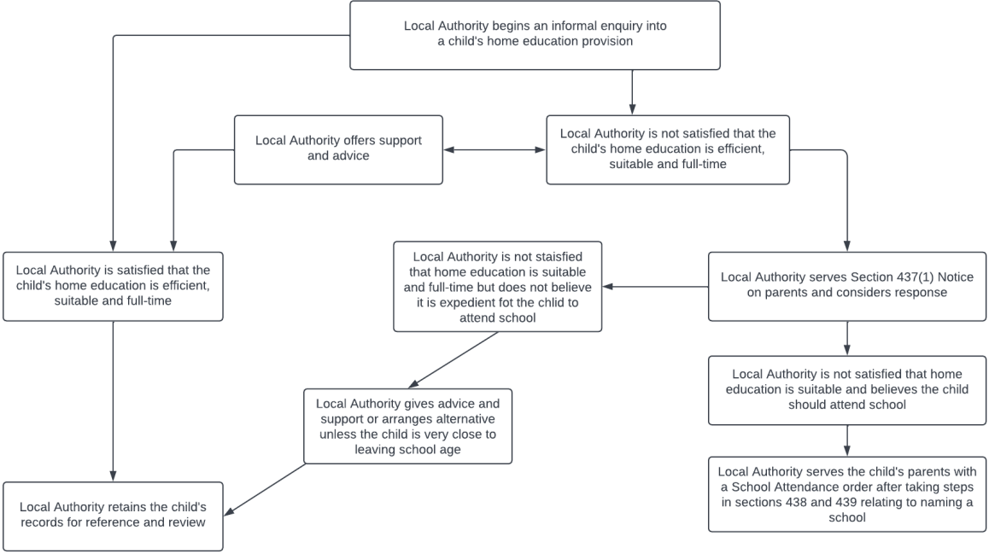
EHE concerns process

Slide 15
CSC and Home Education
If you have concerns that a home educated child is not receiving suitable, full-time education you should report it to the Education Safeguarding Service at...
ess@somerset.gov.uk
Clearly outline your concerns and your current involvement with the family or child – ESS will commence an enquiry to determine the suitability of EHE

Slide 16
School Attendance

Slide 17
Core Offer: Attendance
Underpinned by legislation and statutory guidance
Education Act 1996
Children Act 2006
Penalty Notices (Schools) (England) Regulations 2013
Working Together to Improve School Attendance 2022

Slide 18
Attendance Overview
Schools are required to mark pupil attendance twice a day
190 days per year = 380 sessions
Attendance is recorded on a child’s Registration Certificate
Absences are either authorised or unauthorised – this is decided by the school
ALL ABSENCES contribute to potential concerns about attendance
Unauthorised absences can lead to penalty notices or legal action (O, G, N and U codes)

Slide 19

New Attendance Guidance
Launched in May 2022
Active from September 2022
Statutory from September 2023
Came at a time when attendance was already a key strategic priority across Children’s Services
Working Together to Improve School Attendance

Slide 20
New Attendance Guidance Key Points
Attendance is everyone’s business
Better tracking of attendance
Attendance part of multi-agency, early help response
Working with all schools to improve attendance
Focus on vulnerable groups including children with social workers
and…

Slide 21
Attendance Cohorts
Vulnerable children
CLA, CSC, CE, EHCP
Severe absence
(<50%)
At risk of PA
(approaching 90%)
Persistent absence
(<90%)
Aspirational attendance
expectations for
all children, including
those with a social
worker

Slide 22
Attendance Support
Early Help based
Schools expected to offer or provide support as early as possible
Penalty notices are issued directly when unauthorised holidays are taken (10 or more sessions)
Requests for support taken to Team Around the School
Some result in penalty notices being issued
Some result in legal action being taken
Statutory powers are not used when a child is CLA because..?

Slide 23
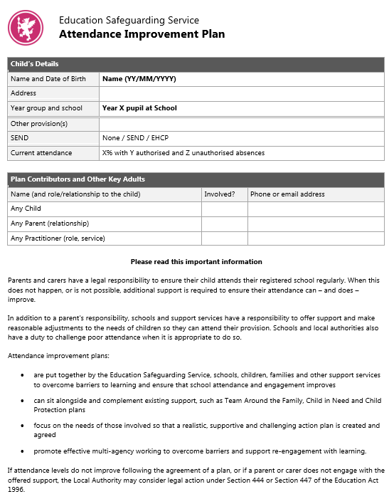
Attendance Casework
Sits within Early Help Framework
Undertaken alongside schools and other support services
Needs-based
Aims to break down barriers to attendance
New elements this year:
Attendance Improvement Plan (AIP)
Attendance Support Requests for children at PRUs
or with SWs
Education Supervision Order

Slide 24
Attendance is everyone’s business
People working with children need to…
Understand what good attendance looks like
Understand what worrying attendance looks like
Hold attendance at the centre of any plans
Question and challenge schools when attendance is poor
Encourage schools to submit requests
Ask us for advice – ess@somerset.gov.uk

Slide 25
Be curious about attendance…
It falls below 90% and certainly below 80%
There are multiple unauthorised absences (O, N, U, and G)
There are a lot of B codes (that can’t be ratified)
There are unexplained absences
A part-time timetable lasts more than six weeks
There are patterns of absence (e.g. every Thursday)
Siblings also have poor attendance – especially patterns
A register does not appear to represent a child’s attendance

Slide 26
Attendance Casework
Agreed through TAS or an Attendance Support Request
Based on Early Help and a graduated support response
Complements multi-agency efforts to support a child
Can be completed in conjunction with / following TELO support
Can sit alongside FIS, CIN and CP plans

Slide 27
Attendance Casework
Allows a flexible response for ESS based on each case
Will be used at the discretion of our officers in line with multi-agency working
Promotes supportive approach
Underpins any legal work, where it is necessary and appropriate
Continues to be used during any legal work undertaken

Slide 28
Legal Work
Only completed when doing so serves the child’s interests
Requires solid and robust level of input and evidence
Process has been simplified to enable faster turn-arounds

Slide 29
Working together

Slide 30
Working and supporting together
EHE Concerns
Safeguarding Concerns
Attendance Concerns
Education and attendance at the heart of CIN and CP plans – even if it’s good
Visit our resources page
Push schools to offer or request
support
Ask us if you’re not sure
Tell us if you’re worried

Slide 31
Additional information

Slide 32

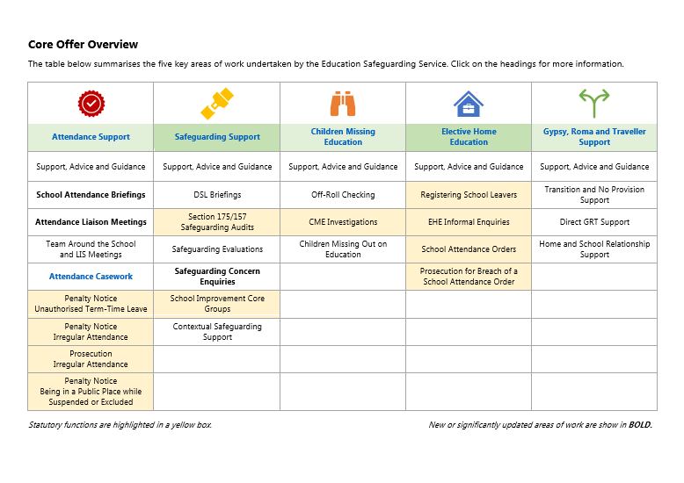
The Core Offer
Our Core Offer is now LIVE and available at www.somerset.gov.uk/ess/resources
It outlines:
our key areas of work
what we do within those areas
how you can access our support

Slide 33
EHE Protocol
Our EHE Protocol is available at www.somerset.gov.uk/ess/resources
It outlines:
What EHE is
What is required of parents, schools and the LA
What processed look like
What support is available

Slide 34
Register Codes
The following slides show the codes that school can use to mark a pupil’s attendance or absence:
Present codes
Unauthorised absence codes
Authorised absence codes
Codes discounted from attendance data
Those highlighted in pink are worth keeping an eye open for, as they may point towards attendance issues.

Slide 35
Register Codes – Present
/ Present (AM)
\ Present (PM)
B Approved off-site learning (school remains responsible)
J Job or educational interview
L Late (before registered closed)
P Approved sporting activity
V School visit
W Work experience

Slide 36
Register Codes – Unauthorised Absence
G Unauthorised term-time leave
N No reason given for absence
O Unauthorised absence
U Late (after registers closed)*
* Schools are advised to keep their registers open for no more than 30 minutes while records attendance for each of their two daily sessions

Slide 37
Register Codes – Authorised Absence
C Authorised absence
E Excluded
F Extended term-time leave
H Term-time leave
I Illness (also shows as I01 or I02)
M Medical appointment (not illness)
R Religious observance
S Study leave
T Traveller absence

Slide 38
Register Codes – Discounted
D Dual registered with another school
X Not required in school (not statutory school age)
Y Unable to attend due to exceptional circumstances*
Z Pupil not on roll
# School closure (school holidays etc.)
* e.g. school closure due to weather, failure of school transport, pupil is in custody (for less than four months) – this coded is counted for statistical purposes but does not count towards pupil or school attendance figures

